Slide 1
Nuclear Fuel Performance
NE-533
Spring 2024

Slide 2
NUMERICAL THERMO-Mechanics

Slide 3
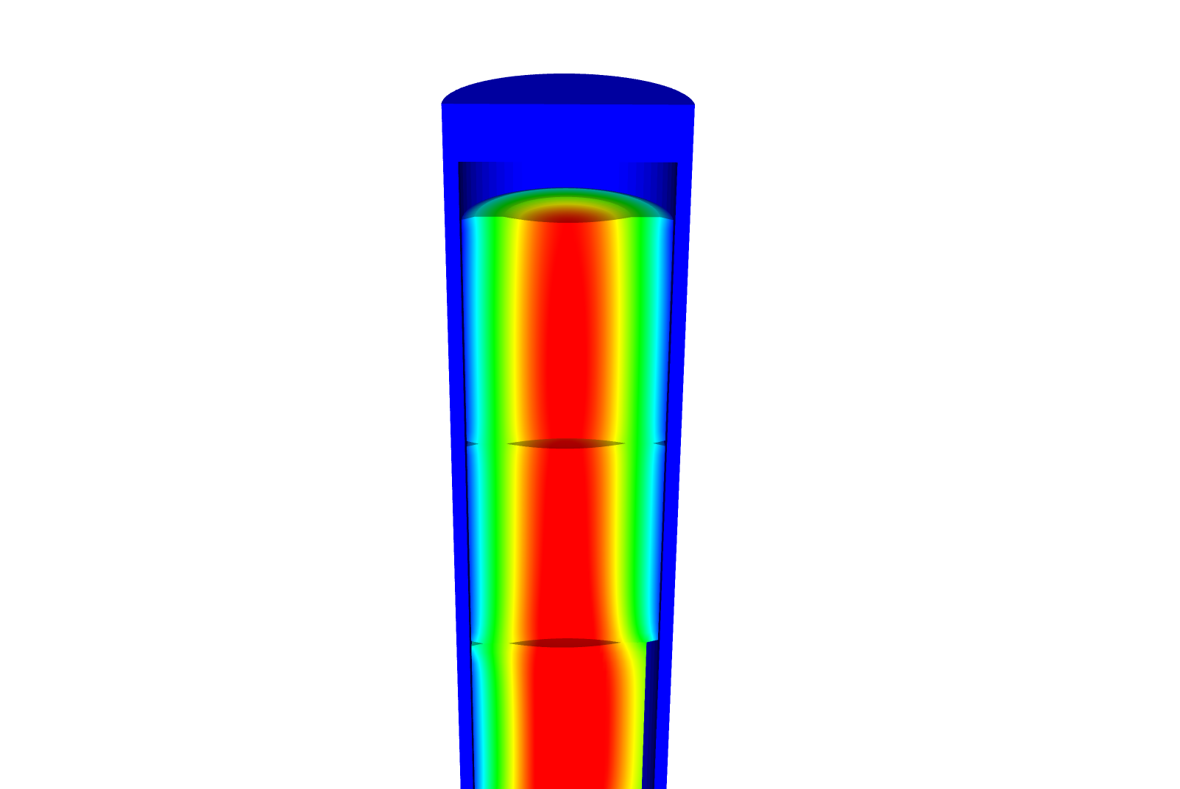
Now we can solve the temperature and the displacement vector for the full thermomechanical problem
T impacts the value of u through thermal expansion
u impacts the value of T through changes in the thickness of the gap
The value for T evolves with time
The value for u also evolves with time, even though there is not time in its PDE

Slide 4
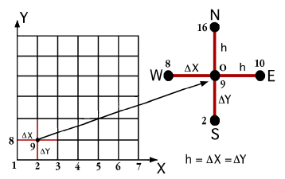


The primary tool for solving all thermomechanics problems is the finite element method
Finite difference
Can solve the heat conduction equation
Can’t easily solve the mechanics equations
Finite Volume
Can solve the heat conduction equation
Can solve the mechanics equations
Eqns derived from fluid dynamics
Finite Element
Can solve the heat conduction equation
Can solve the mechanics equations
Can handle any geometry
Can handle any boundary condition

Slide 5
The 1D thermomechanics problem definition
dT/dr = 0
u_{r} = 0
R_{f}
T_{r} = T_{s}
du_{r}/dr = 0
r
The initial temperature is set to 273 K
We will take 50 time steps of 0.5 s
The full power of Q = 450 begins at time t = 0.
UO₂ material properties are used for both the thermal and mechanics equations

Slide 6
Comparison to analytical theory
If we use a constant thermal conductivity, analytical 1D model matches very well
When k is a function of temperature, there is a difference between the FEM and analytical stress

Slide 7
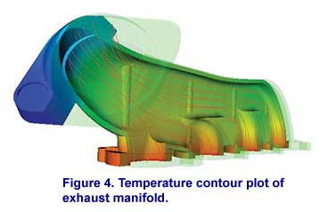
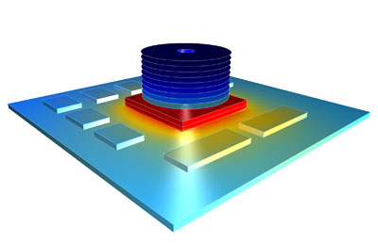

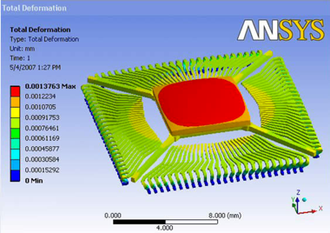

There are various available tools for solving coupled thermomechanical problems with FEM
Commercial tools
ABAQUS
ANSYS
COMSOL
Open source
MOOSE
NRC-based
FRAPCON/FRAPTRAN

Slide 8
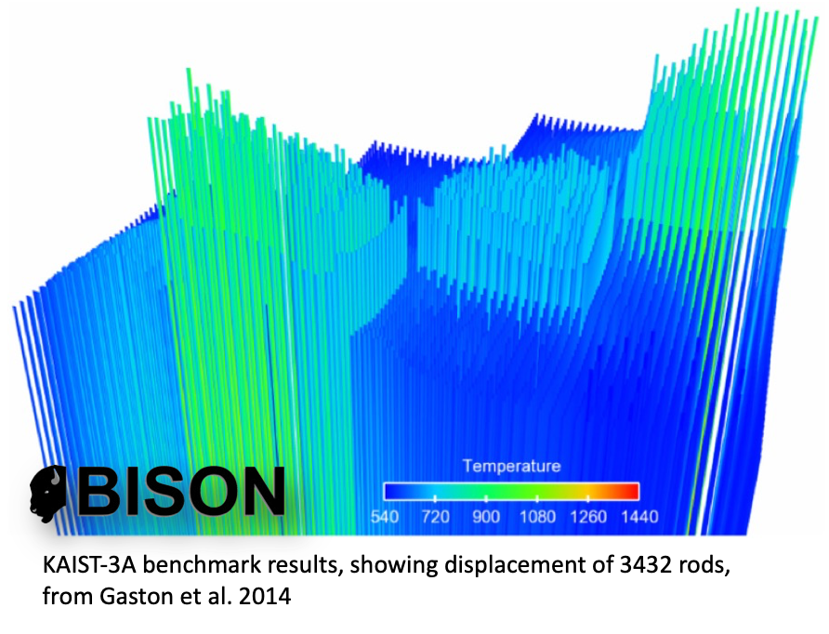
The purpose of a fuel performance code is to simulate and evaluate fuel rod behavior
The first fuel performance codes were developed in the mid seventies
Advanced fuel performance codes are still under development today

Slide 9
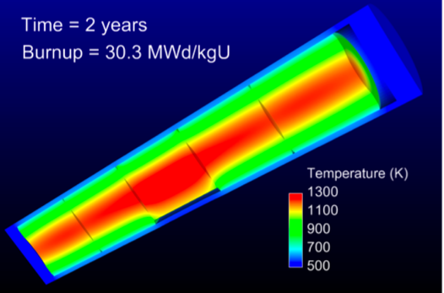
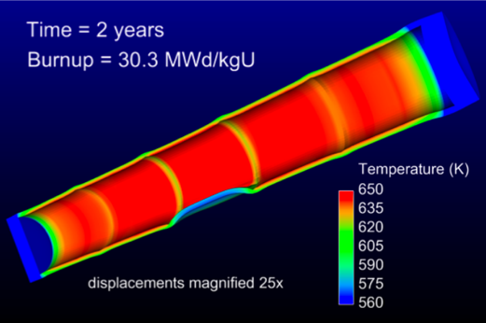
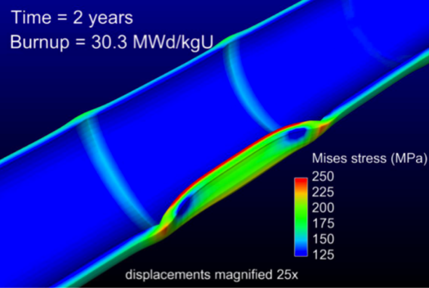
How are fuel performance codes used?
The primary goals are to predict the fuel centerline temperature and the stress in the cladding
Fuel performance codes aren’t focused on predicting power production, but rather to predict safety margins, provide coupling to other codes

Slide 10
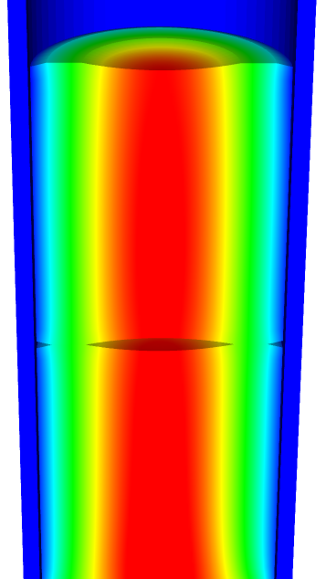
A fuel performance code must be able to predict:
Fuel
Temperature profile
Volumetric change
Gap
Gap heat transport
Mechanical interaction between fuel and cladding
Gap pressure
Cladding
Temperature profile
Stress

Slide 11
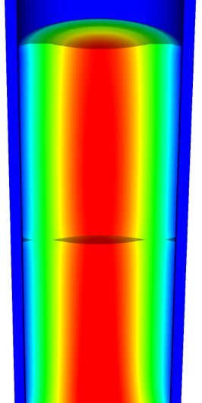
The primary focus is solving the thermomechanical problem
Fuel
Solved Numerically
Gap
The handling of the gap changes the most between different codes
Solved Numerically or analytically
Cladding
Solved Numerically or analytically
Solved Numerically

Slide 12

Various approaches to model the fuel rod
Transient, full 3D
Transient, 2D axisymmetric with discrete pellets
Computational cost
Accuracy
Transient, 2D axisymmetric with smeared pellets
Transient, multiple 1D slices (1.5D)
Steady, multiple 1D slices (1.5 D)
Transient, 1D
Steady state, 1D (analytical)

Slide 13
Early fuel performance codes were made for either steady state or transient operation
Steady state codes
Leave off the time derivative part of the heat equation
The material properties still evolve with time as a function of burnup
The volumetric changes in the fuel are also a function of burnup
Creep of fuel and cladding change with time
Transient codes
Include the time derivative
Have similar burnup dependent models like steady state codes, but don’t include creep
Have additional models for rapid transients

Slide 14
Start with FRAPCON
Transient, full 3D
Transient, 2D axisymmetric with discrete pellets
Computational cost
Accuracy
Transient, 2D axisymmetric with smeared pellets
Transient, multiple 1D slices (1.5D)
Steady, multiple 1D slices (1.5 D)
Transient, 1D
Steady state, 1D (analytical)

Slide 15
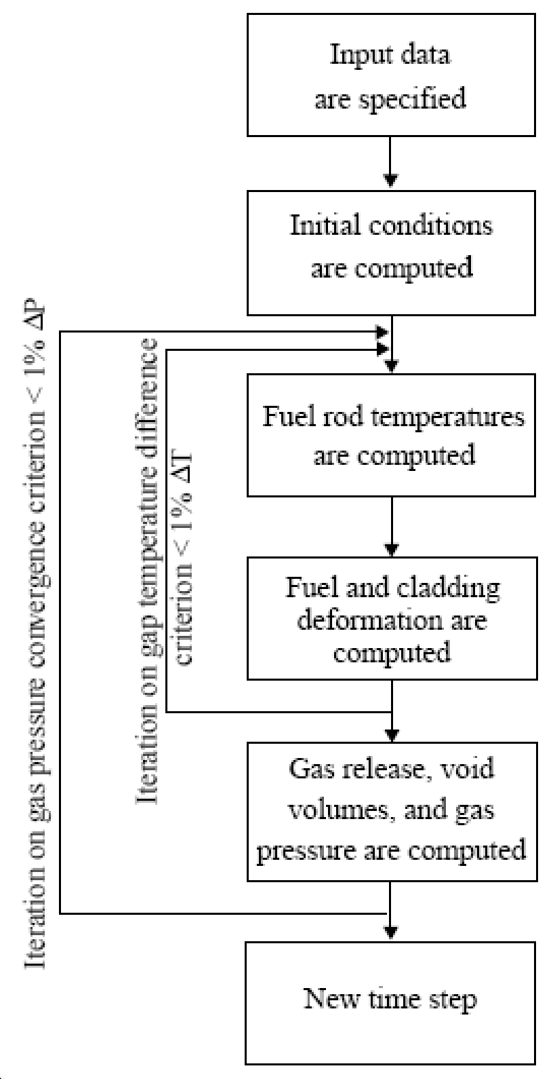
FRAPCON Flow Chart
FRAPCON is the NRC’s steady-state fuel performance code
FRAPCON has the ability to accurately calculate the high-burnup response of light-water reactor fuel rods
FRAPCON iterates to determine fuel rod temperatures, fuel and cladding deformation
This converged data is iterated to produce gas release, void volumes and plenum pressure
Then marches forward in time

Slide 16
FRAPTRAN
Transient, full 3D
Transient, 2D axisymmetric with discrete pellets
Computational cost
Accuracy
Transient, 2D axisymmetric with smeared pellets
Transient, multiple 1D slices (1.5D)
Steady, multiple 1D slices (1.5 D)
Transient, 1D
Steady state, 1D (analytical)

Slide 17
FALCON
Transient, full 3D
Transient, 2D axisymmetric with discrete pellets
Computational cost
Accuracy
Transient, 2D axisymmetric with smeared pellets
Transient, multiple 1D slices (1.5D)
Steady, multiple 1D slices (1.5 D)
Transient, 1D
Steady state, 1D (analytical)

Slide 18
FALCON
FALCON is a 2D fuel performance code developed by EPRI
Development of FALCON started in 1996
The beta version was released in 2003
It was developed by ANATECH for EPRI
FALCON is proprietary, owned by EPRI
It is no longer under active development in the US

Slide 19
FALCON is a 2D transient and steady state code
Fuel
Solved with FEM
Gap
Pressure is calculated using equation of state
Simplified contact model is used for gap closure
Gap heat transfer model is used
Solved with FEM
Cladding
Solved with FEM
Solved with FEM

Slide 20
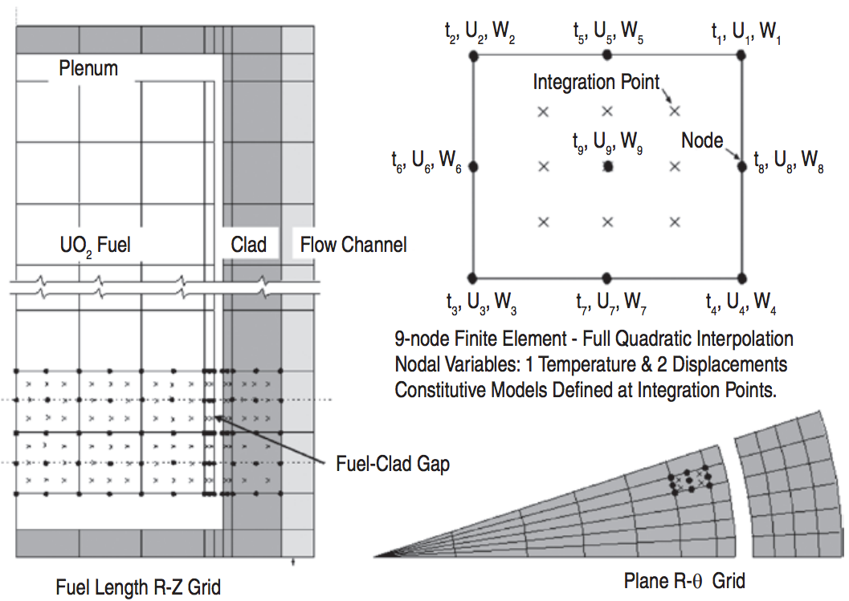
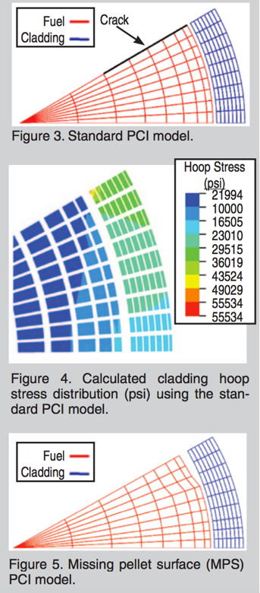
FALCON can predict the fuel performance in axisymmetric RZ space or in Rθ space

Slide 21
BISON
Transient, full 3D
Transient, 2D axisymmetric with discrete pellets
Computational cost
Accuracy
Transient, 2D axisymmetric with smeared pellets
Transient, multiple 1D slices (1.5D)
Steady, multiple 1D slices (1.5 D)
Transient, 1D
Steady state, 1D (analytical)

Slide 22
BISON
The next generation fuel performance code under development in the US
It uses the MOOSE framework
Development was begun in 2008
The first paper using BISON was published in 2009 and the paper summarizing its full capabilities was published in 2012
It was developed at Idaho National Laboratory, with some support by ANATECH
BISON is available for free, but it is export controlled and requires a license agreement be signed

Slide 23
BISON models the fuel behavior ranging from 1D to full 3D and uses FEM
Fuel
Solved with FEM
Gap
Pressure is calculated using equation of state
Fully implemented implicit contact algorithm
Gap heat transfer model is used
Solved with FEM
Cladding
Solved with FEM
Solved with FEM

Slide 24
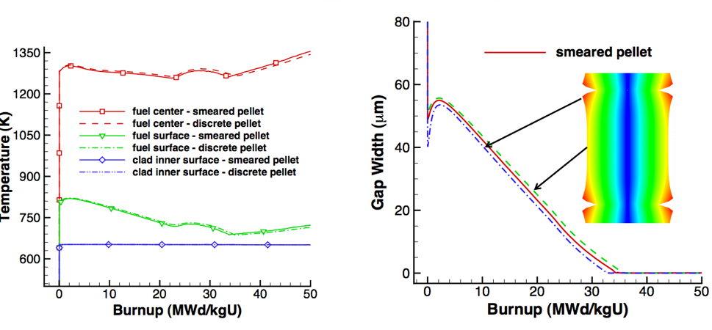
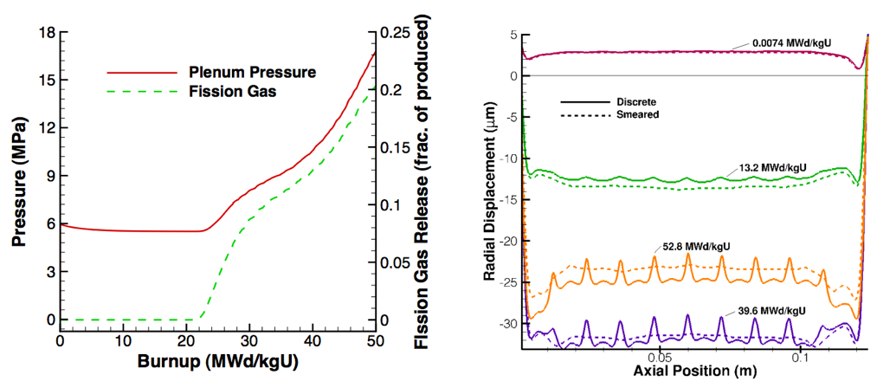
Can handle smeared or discrete pellets, asymmetric pellet geometry and deformation

Slide 25
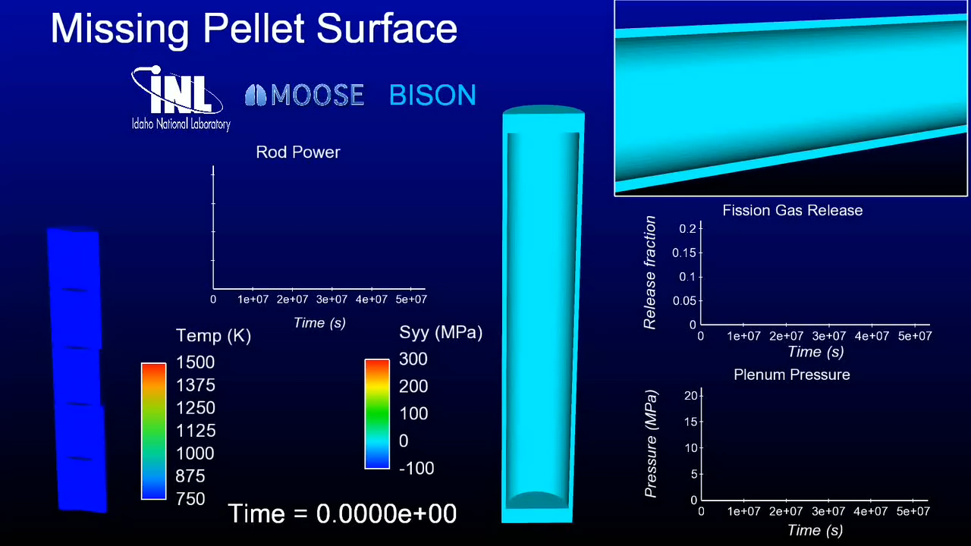
Because of its unique 3D capability, BISON can model truly 3D fuel performance problems

Slide 26
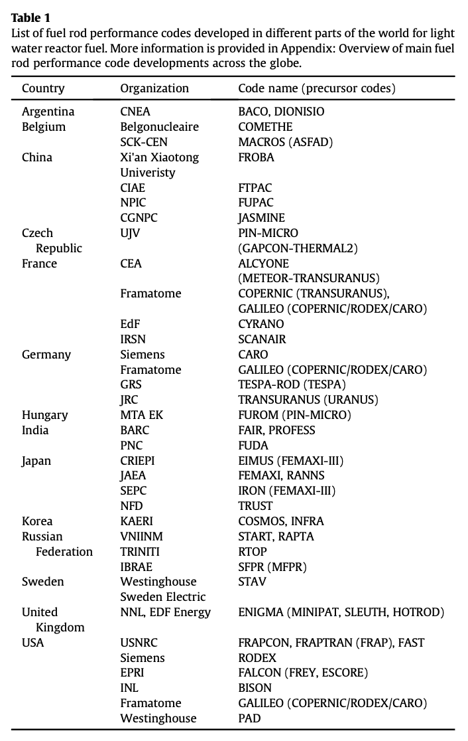
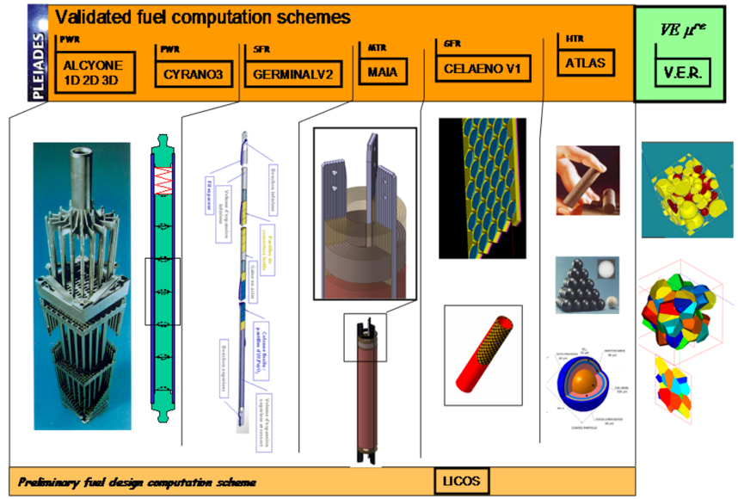
Other countries have other fuel performance codes
http://www.materials.cea.fr/en/PDF/PLEIADES-Platform.pdf

Slide 27
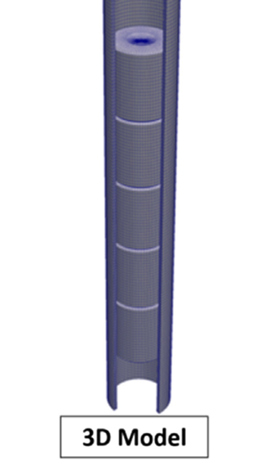
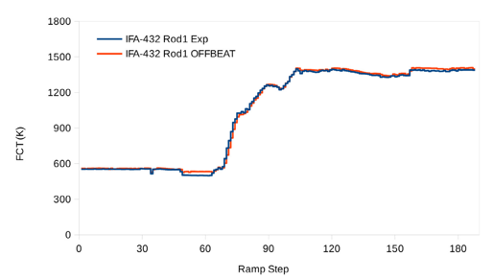
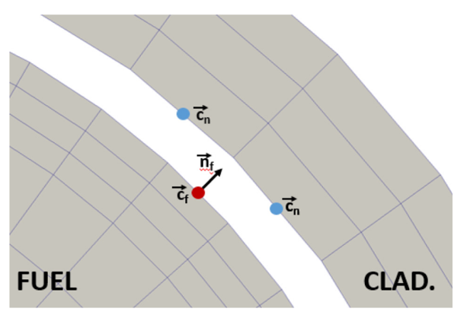
OFFBEAT – new tool
The OpenFOAM Fuel BEhavior Analysis Tool (OFFBEAT) is a multi-dimensional fuel performance code developed in Switzerland
The code can be used both for studying complex 2D or 3D local effects and for more traditional 1.5D base irradiation analyses
OFFBEAT is based on the open-source C++ library OpenFOAM, thus the governing equations are discretized with modern finite volume techniques

Slide 28
Summary
Fuel performance codes are focused on predicting the center temperature of the pellet and the stress in the cladding
All fuel performance codes
Numerically model the temperature in the fuel
Numerically model the stress in the cladding
And consider gap pressure, closure, and heat transfer in some way
The primary US codes are
FRAPCON – Steady state 1.5D, uses finite difference
FRAPTRAN – Transient 1.5D, uses finite difference
FALCON – Steady or transient 2D, uses finite element
BISON – Steady or transient, 1D – 3D, uses finite element

